Slide 1

Bank Loan of Customers
By - Sonam Phadtare

Slide 2
Objective
This project involved analyzing two datasets containing customer loan information with 39,000 rows each. The objective was to assess the bank's loan growth over a certain period. To accomplish this, various tools were utilized:
Data Cleaning and Analysis: Excel and MySQL were used to clean the data, perform analysis, and remove duplicates from the datasets.
Dashboard Creation: Tableau and PowerBI were employed to create interactive dashboards. These tools facilitated calculations, merging of datasets, and visualization of key metrics related to loan growth.
Overall, the project aimed to provide insights into the bank's loan portfolio and track its growth over time through the creation of visually appealing and informative dashboards.

Slide 3
Contents
KPI-1 : Year wise loan amount Stats
KPI-2 : Grade and sub grade wise revol_bal
KPI-3 : Total Payment for Verified Status Vs Total Payment for Non Verified Status
KPI-4 : State wise and last_credit_pull_d wise loan status
KPI-5 : Home ownership Vs last payment date stats

Slide 4
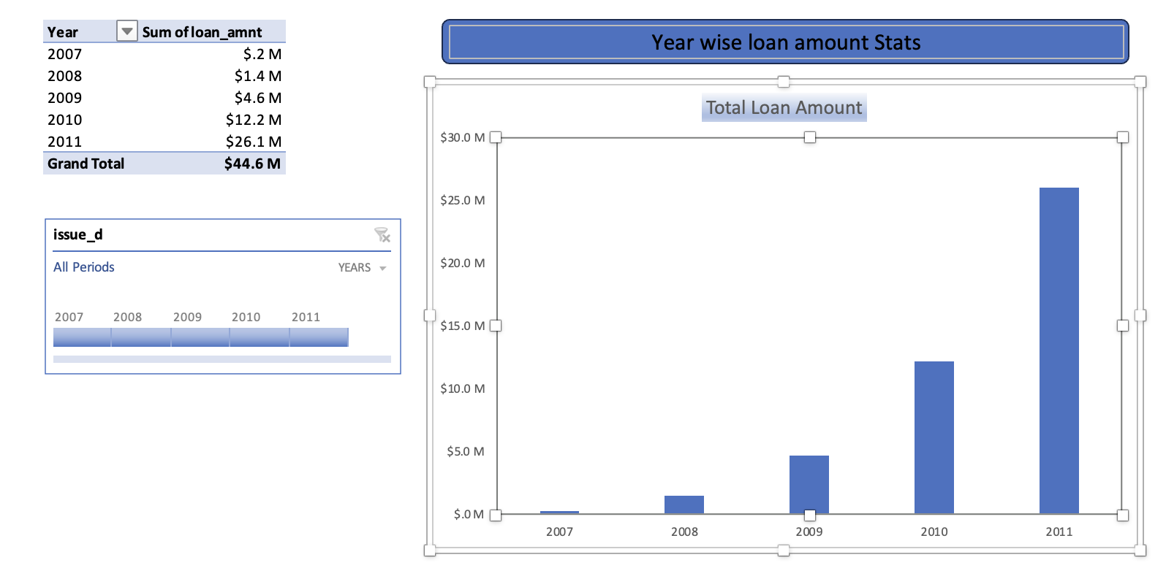
KPI-1 : Year wise loan amount Stats
By examining the chart, we can observe a consistent increase in the loan amount over the years. For instance, from 2007 to 2011, the loan amount surged from 22,19,275 to 26,05,06,575.
Calculating the difference between these two amounts shows an increase of 258,287,300 over a span of 4 years. The grand total of all years amounts to 44,56,02,650.00.
This indicates a substantial growth in the loan portfolio over the analysed period.

Slide 5
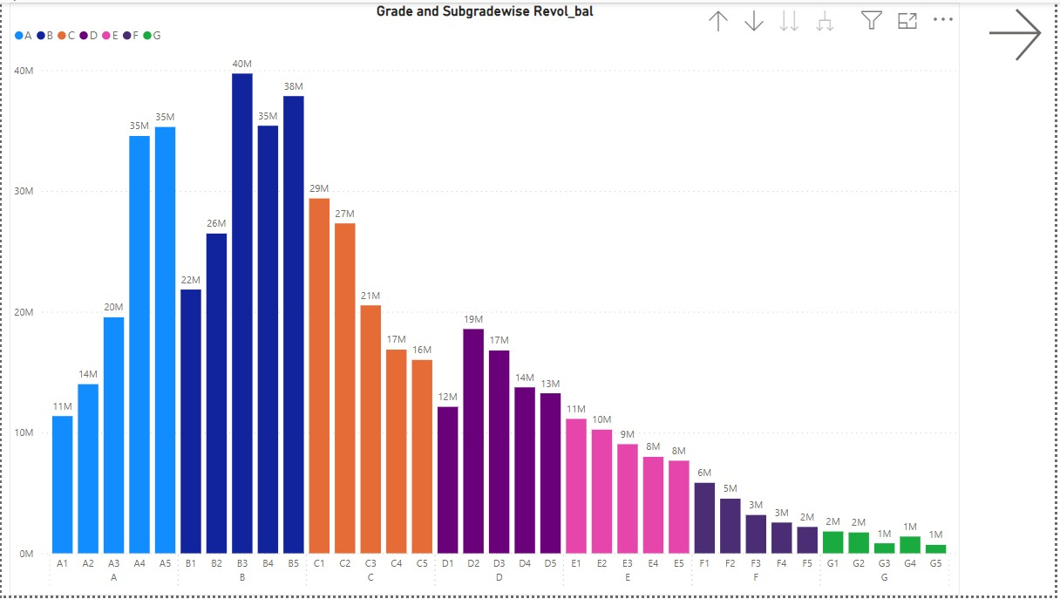
KPI-2 : Grade and sub grade wise revol_bal
Grade B: Among all grades, B exhibits the highest revolving balance. Specifically, subgrade B3 stands out with a substantial revolving balance of $40 million.
Grade C: Although not as high as B, C also shows an increasing trend in revolving balances. Subgrade C1 reaches a notable balance of $29 million. While Subgrade C5 being 16M
Grades D and E: These grades have lower overall balances. D2 peaks at $19 million, while E1 reaches $11 million.
Grades F and G: These grades have the lowest balances. F1 reaches $6 million, while all G subgrades are either at $2 million or $1 million.
Optimizing lending practices based on grade and subgrade insights ensures better risk management.

Slide 6
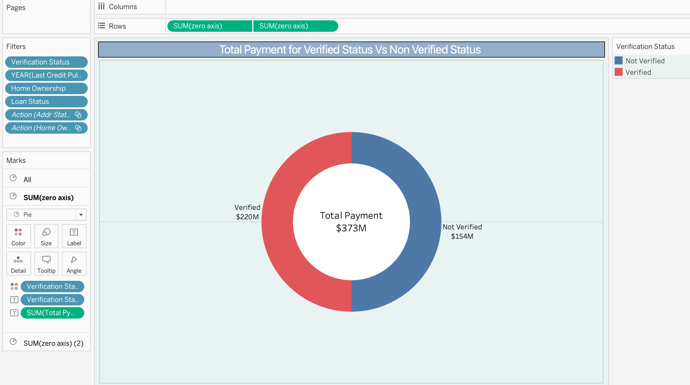
KPI-3 : Total Payment for Verified Status Vs Total Payment for Non Verified Status
Verified Loans:
Loans that have undergone through verification processes, ensuring their legitimacy and borrower credibility. Verified loans account for a total payment are of $220 million.
Not Verified Loans:
Loans that lack full verification or may have incomplete documentation. Not verified loans contribute $154 million to the overall payment pool.
Comparison:
Verified loans significantly outweigh not verified loans in terms of total payment. The verification status directly impacts the risk profile and repayment reliability of borrowers.

Slide 7
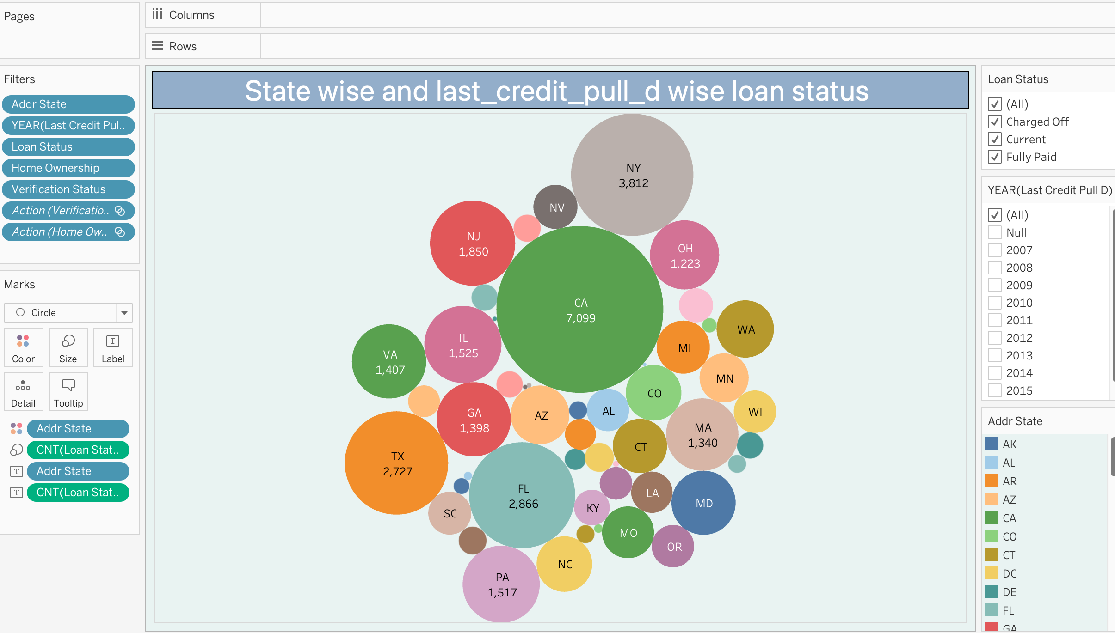
KPI-4 : State wise and last_credit_pull_d wise loan status
The bubble chart demonstrates the count of loan status in each state of the USA on the last credit pull date. There are 50 states to which bank has granted loan for various purpose, out of which CA, NY, TX, FL, NJ are top 5 states with highest Fully Paid, Charged Off and Current loan status.
The State with Lowest Loan amount is ME.

Slide 8
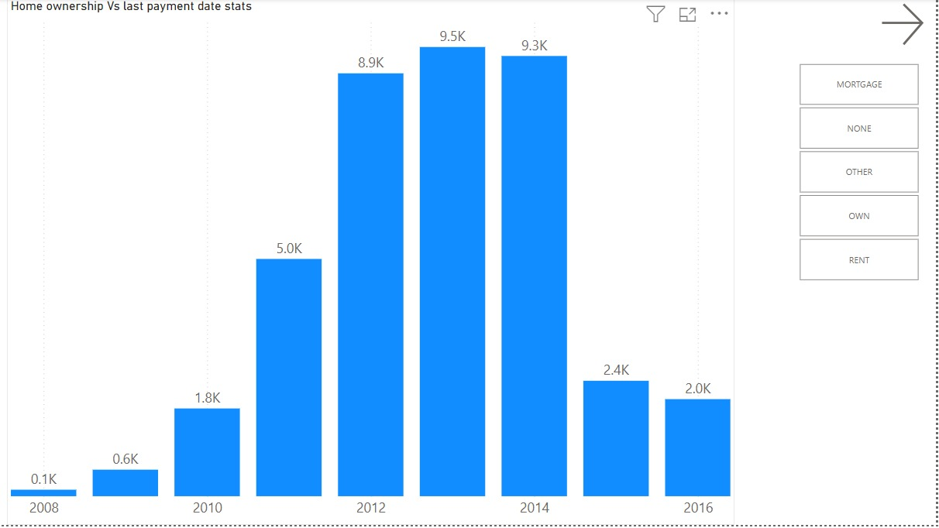
KPI-5 : Home ownership Vs last payment date stats
Between 2008 and 2014, there was a gradual increase in the count of home ownership loans. However, from 2014 to 2016, this count began to decline.
Upon closer examination, it was found that California had the highest count of rent home ownership loans among all states.
Additionally, the analysis indicated that both rent and mortgage loans were widely accepted within the home ownership loan category, suggesting a diverse range of financing options being utilized by borrowers in this sector.

Slide 9
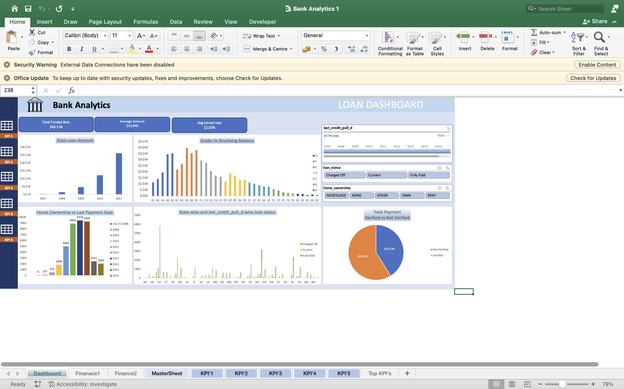
Excel Dashboard

Slide 10
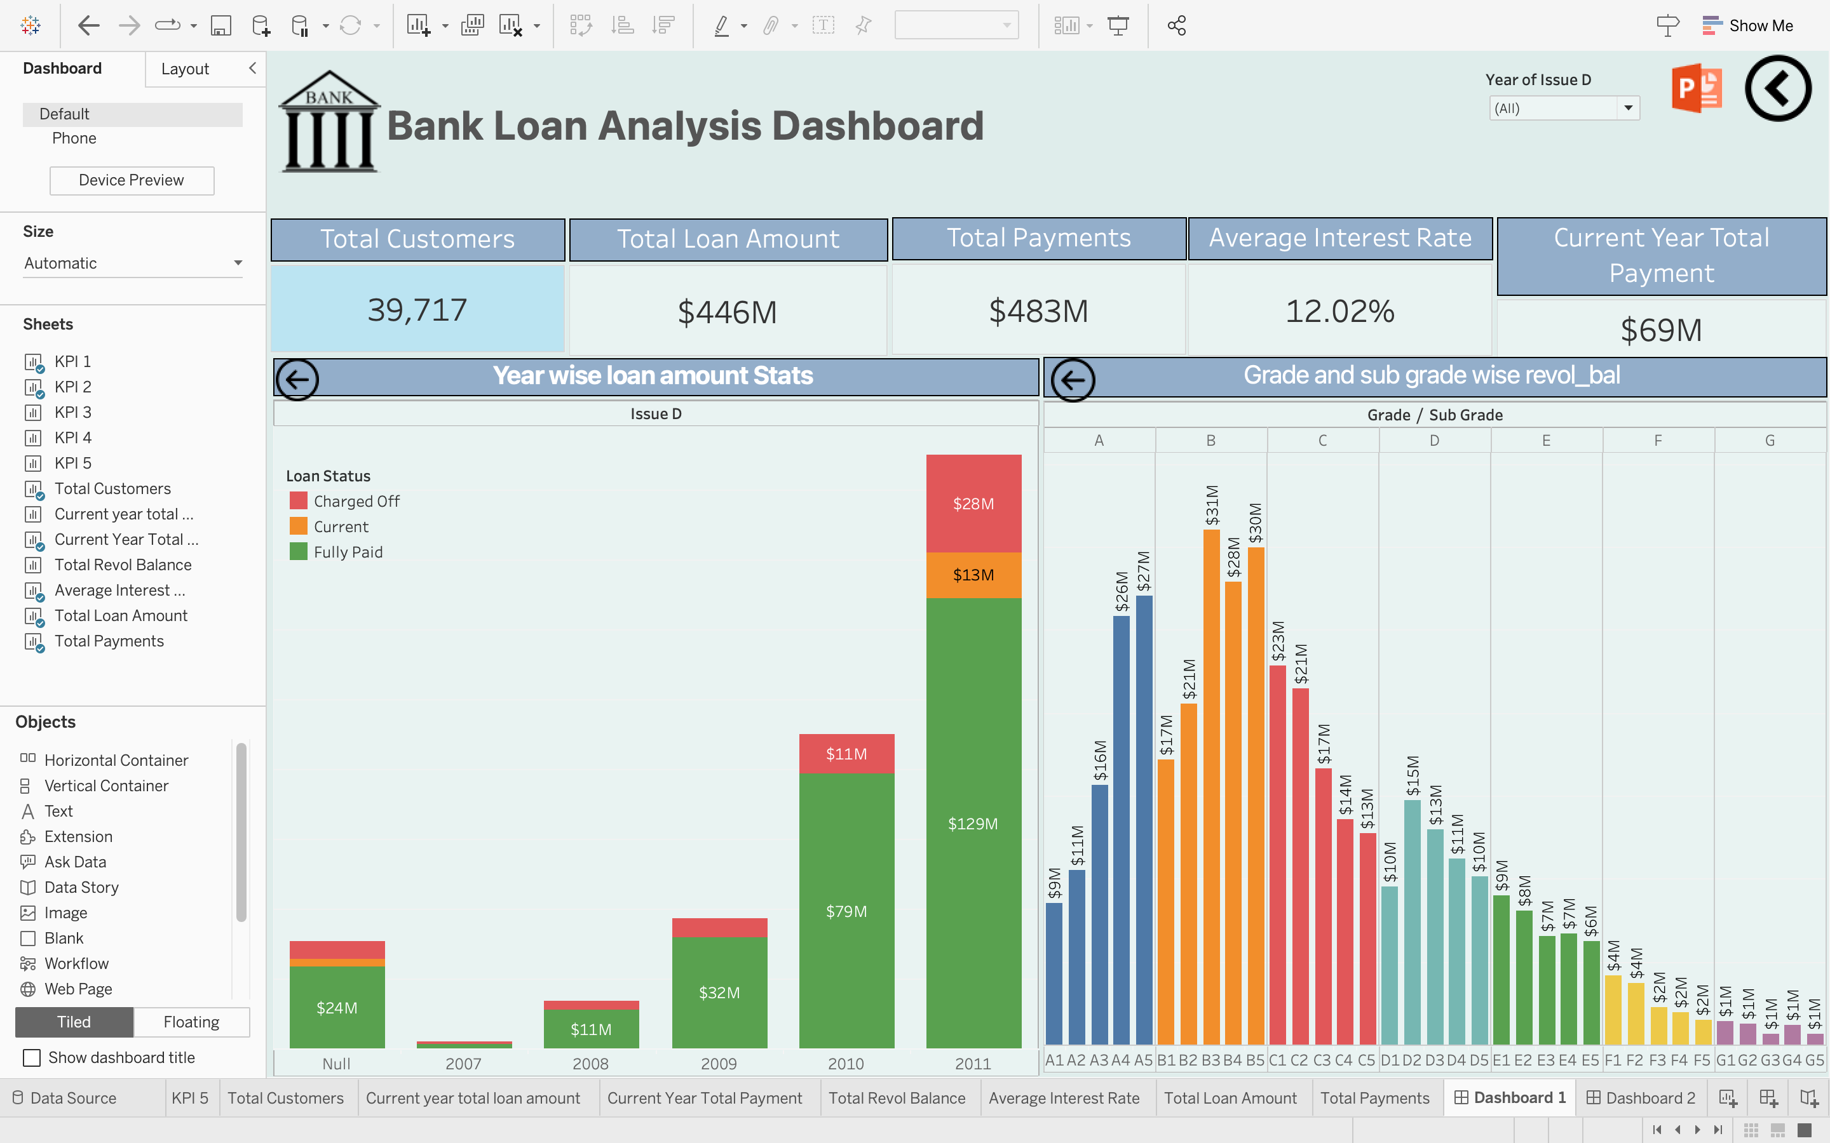
Tableau Dashboard

Slide 11
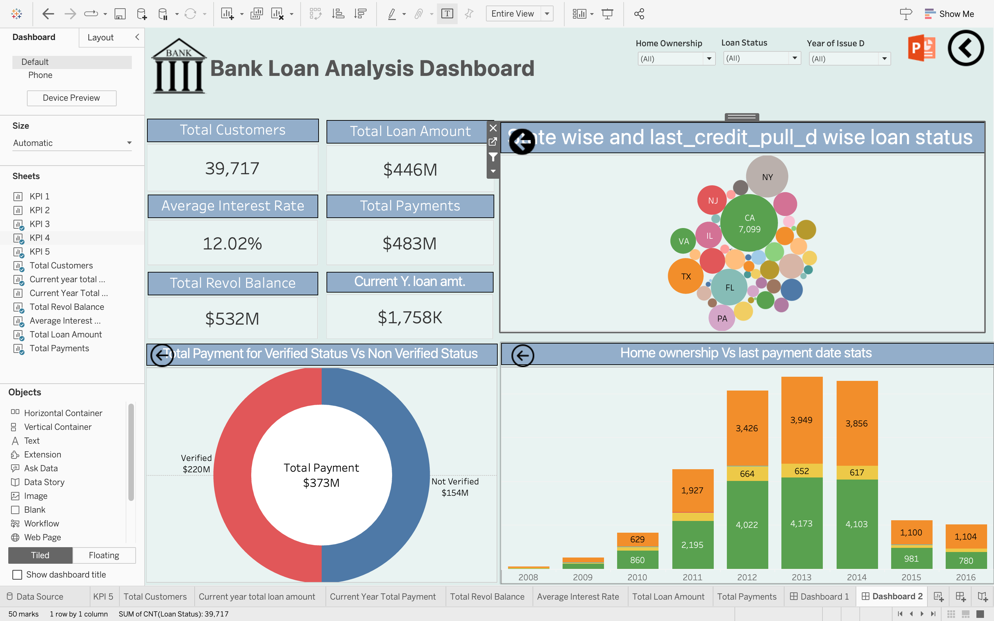
Tableau Dashboard

Slide 12
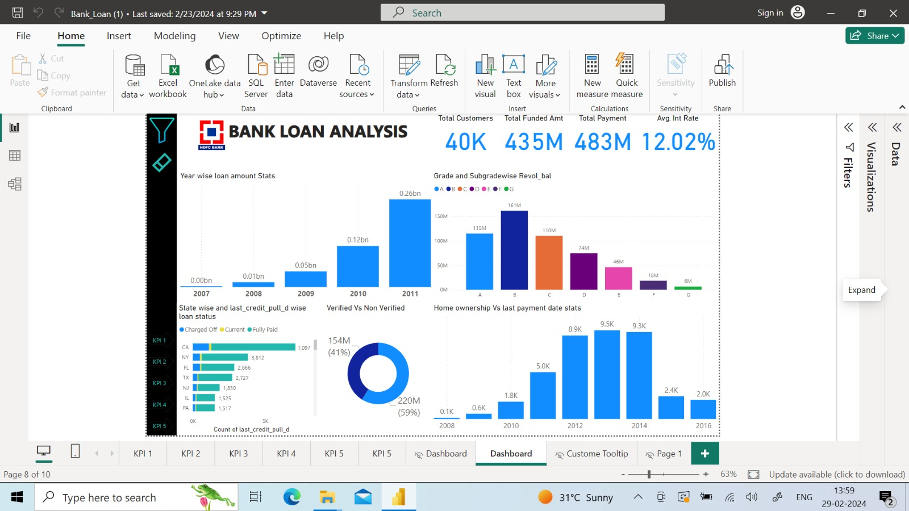
Power BI Dashboard

Slide 13
Thank you

